Slide 1

Azure-Based Situation-Aware Cricket Analytics
T Chetan Satvik – 2320090026
Ch Nikith – 2320090023
K Venkata Vihaari - 2320090027

Slide 2
INTRODUCTION & MOTIVATION
Introduction
Modern analytics requires scalable cloud platforms
Large cricket datasets need flexible storage & processing
Insights must be delivered through interactive dashboards
Cloud enables centralized analytics access
Motivation
Big Data insights alone are not sufficient
Teams require visual, real-time decision support
Need scalable and accessible analytics platform

Slide 3
INTRODUCTION & MOTIVATION
Real-World Relevance
Sports organizations use cloud analytics platforms
Cloud allows faster processing and visualization
Supports real-time decision making

Slide 4
OBJECTIVES
Primary Objective
Build a cloud-based analytics platform to deliver situation-aware cricket insights
Specific Goals
Store cricket datasets using Azure storage services
Manage structured and semi-structured data
Process analytics data using Azure services
Create interactive Power BI dashboards
Provide decision-support visualization

Slide 5
OBJECTIVES
Expected Outcome
Cloud-hosted analytics system
Real-time style dashboards for batting decisions

Slide 6
LITERATURE SURVEY
Existing Work
Cloud platforms widely used for analytics solutions
Azure supports scalable data storage and analytics workloads
Power BI used for sports performance visualization
Limitations
Most systems focus only on reporting dashboards
Limited integration with match-situation analytics
Gap Identified
Lack of cloud platforms delivering situation-aware cricket decision analytics

Slide 7
PROPOSED METHODOLOGY
Overall Approach
Extend Big Data insights into cloud environment
Use Azure services for storage, processing, and visualization
Workflow
Data Upload to Azure Storage
Data Processing & Management
Database Integration
Dashboard Creation
Insight Delivery

Slide 8
SYSTEM ARCHITECTURE
Data Source: Processed cricket datasets
Azure Blob Storage → raw data storage
Azure SQL Database → structured analytics data
Azure Cosmos DB → semi-structured match data
Power BI → visualization & dashboards

Slide 9
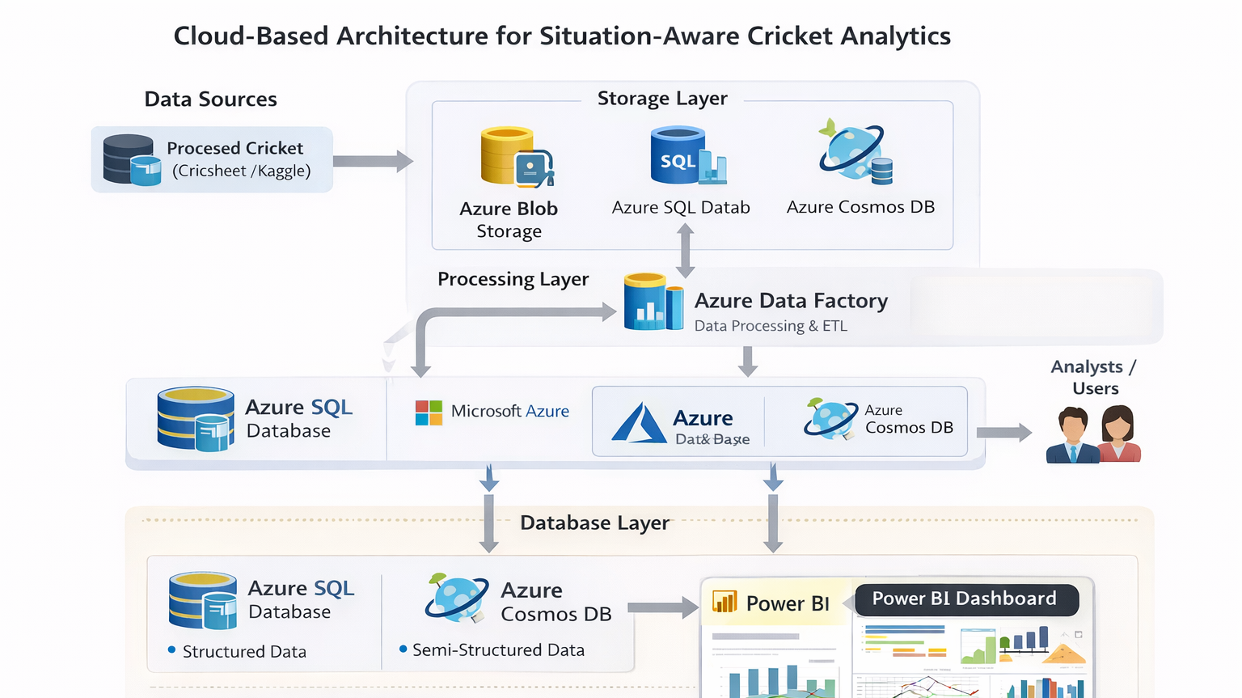

Slide 10
DATA & CLOUD SERVICES USED
Azure Services
Azure Blob Storage
Azure SQL Database
Azure Cosmos DB
Azure Storage Services
Power BI
Data Types
Structured data (tables)
Semi-structured data (JSON match data)

Slide 11
ANALYTICS & VISUALIZATION
Dashboard Features
Match situation overview
Player suitability comparison
Situation-wise performance charts
Batting recommendation panel
Visualization Benefits
Easy interpretation of insights
Interactive filtering
Decision-support interface

Slide 12
DATA ROLES & WORKLOADS
Data Roles
Data Engineer → Data storage & pipelines
Database Administrator → Azure database management
Data Analyst → Dashboard creation
Workloads
Transactional → Data ingestion
Analytical → Performance analysis

Slide 13
EXPECTED RESULTS
Cloud-hosted cricket analytics platform
Interactive Power BI dashboards
Visualization of match situations
Easy access to analytics insights

Slide 14
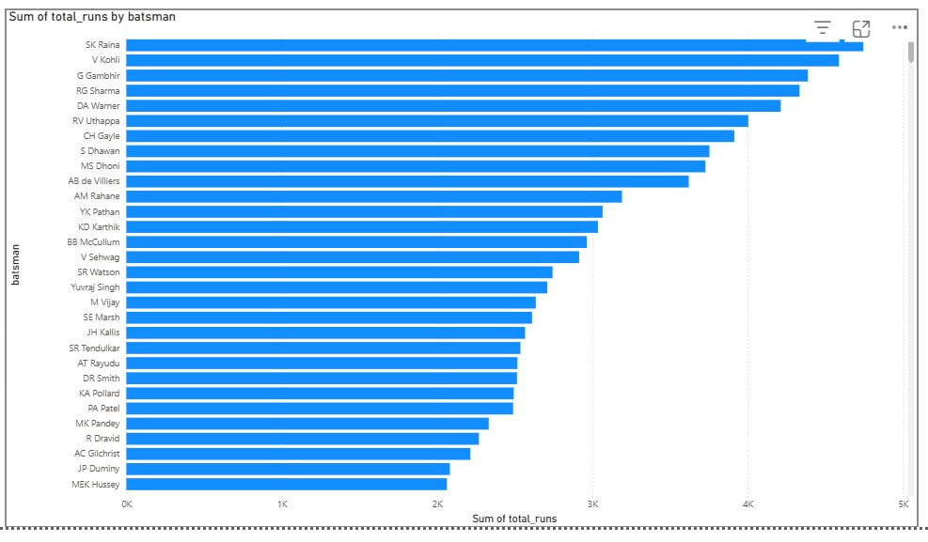
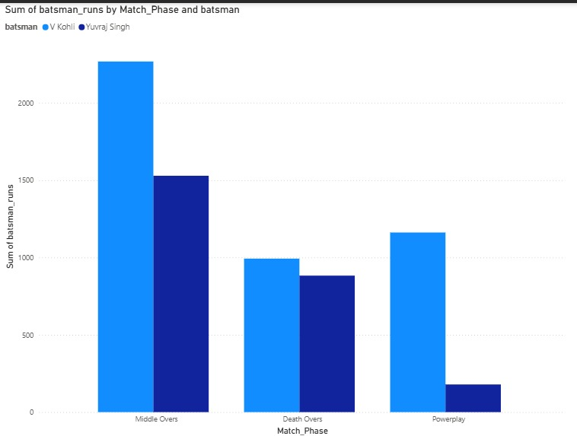
OUTPUT

Slide 15
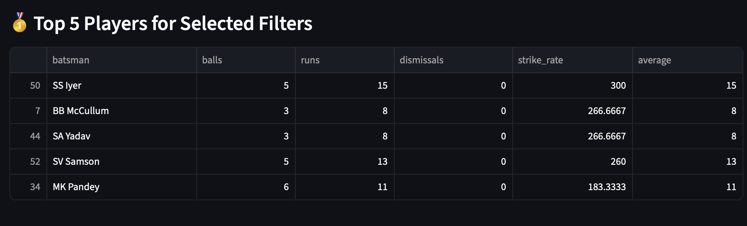
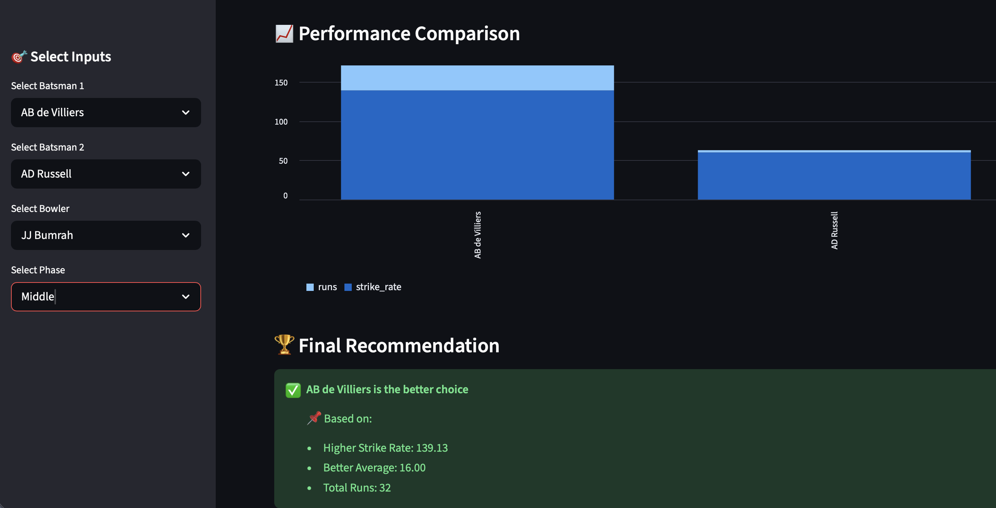
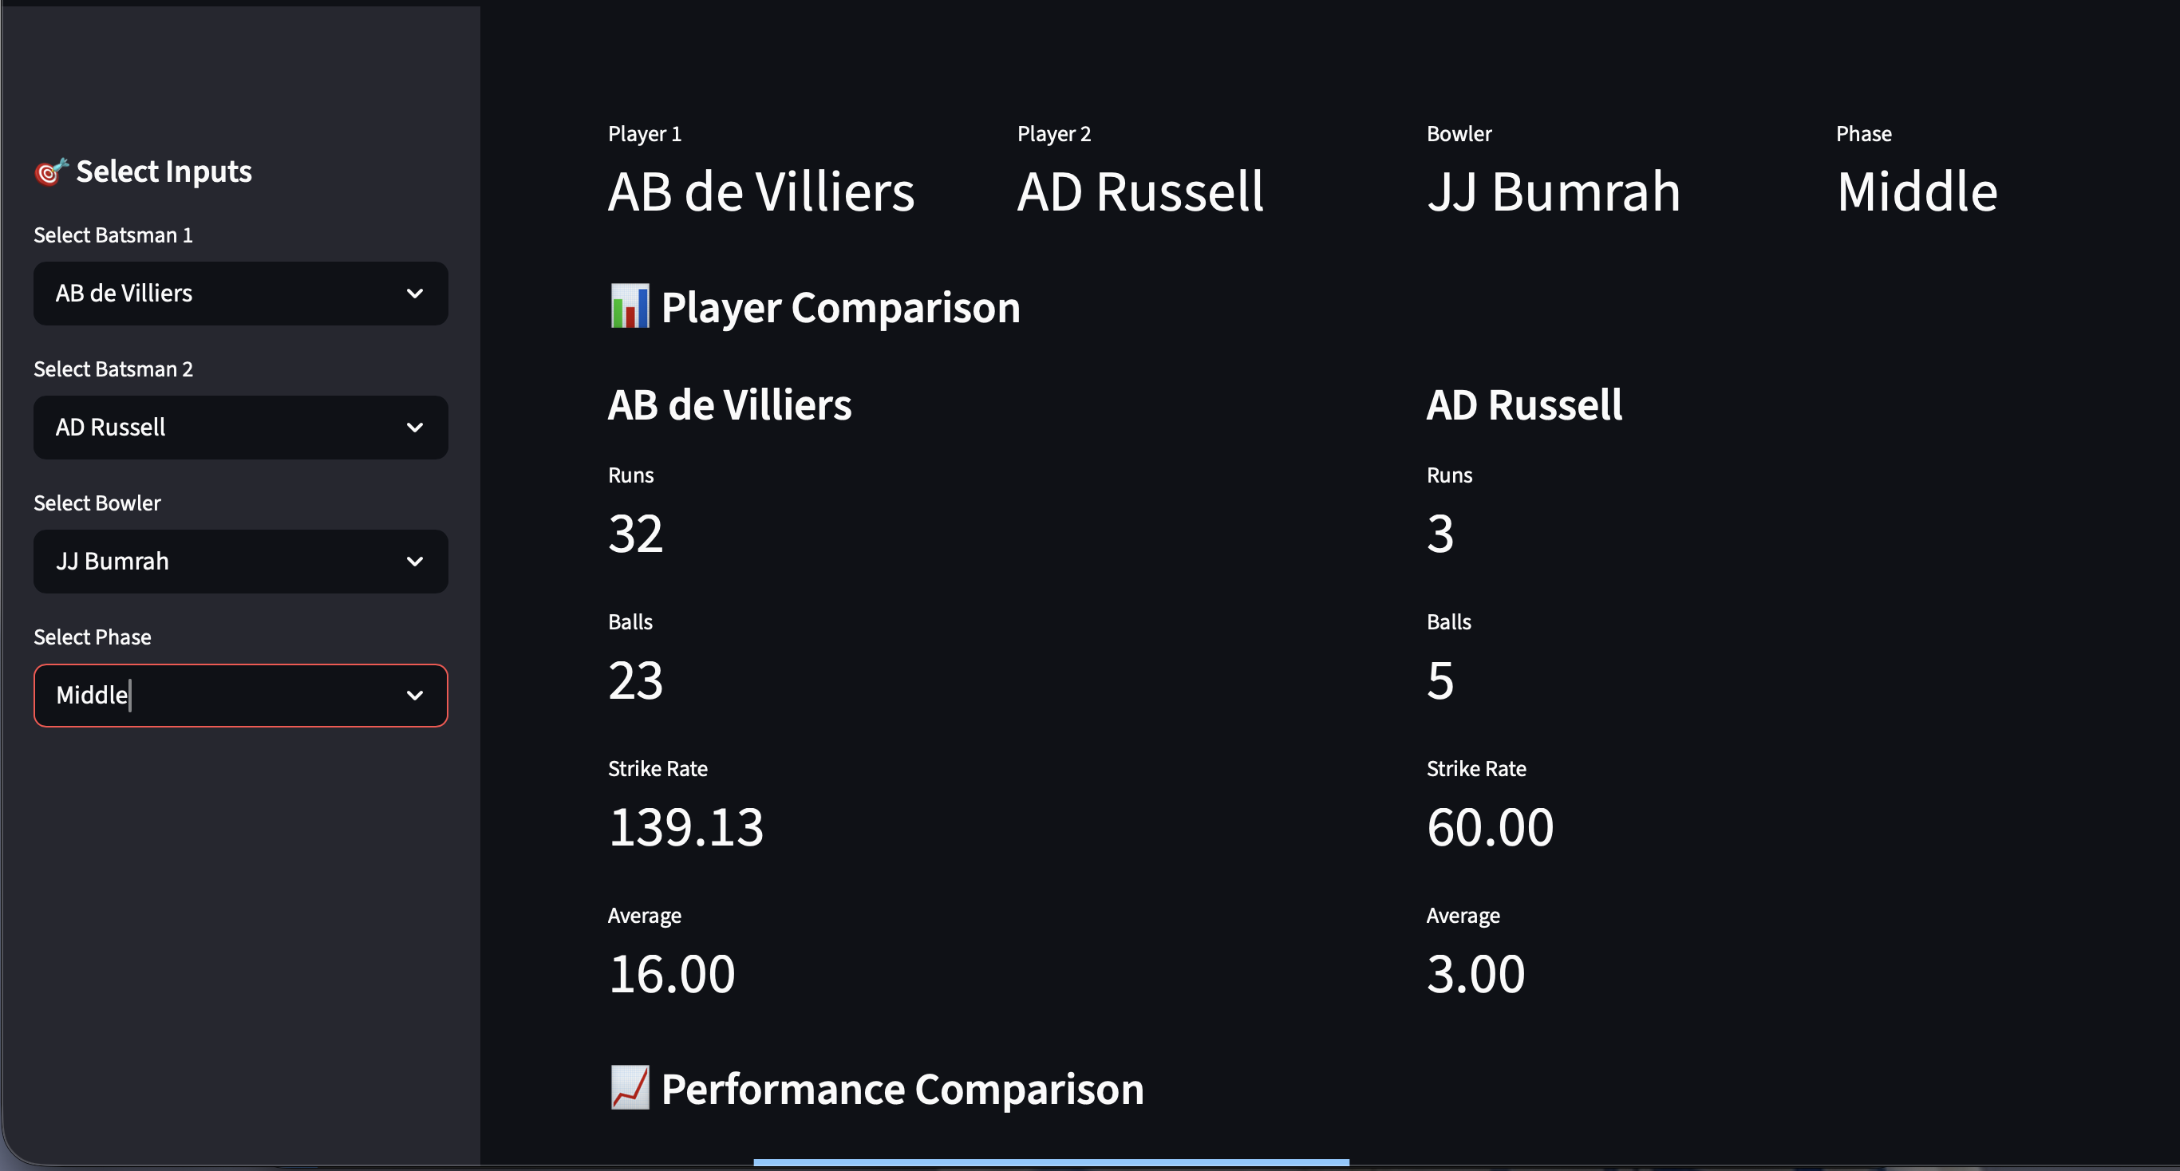

Slide 16
DELIVERABLES
Azure cloud architecture
Stored cricket datasets
Power BI dashboards
Analytical visual reports

Slide 17
REFERENCES
Data Analytics & Machine Learning Applications for Player Selection in Cricket (2024)
Systematic Review of Performance Indicators in T20 Cricket (2025)
AI in Cricket Analytics: Transformative Models for Prediction(2026)
Azure Analytics Platform Architecture Design (2024)

